Slide 1

Advanced NLP (Introduction)
NLP
Dr. Sajarwo Anggai, S.ST., M.T. NIDN : 0421108703

Slide 2
What is NLP
Natural language processing (NLP) is a subfield of computer science and artificial intelligence (AI) that uses machine learning to enable computers to understand and communicate with human language (IBM).
Natural language processing (NLP) is a branch of artificial intelligence (AI) that enables computers to comprehend, generate, and manipulate human language. Natural language processing has the ability to interrogate the data with natural language text or voice (Oracle).
https://www.ibm.com/topics/natural-language-processing
https://www.oracle.com/id/artificial-intelligence/what-is-natural-language-processing/

Slide 3
What is NLP
NLP enables computers and digital devices to recognize, understand and generate text and speech by combining computational linguistics—the rule-based modeling of human language—together with statistical modeling, machine learning (ML) and deep learning.
NLP research has enabled the era of generative AI, from the communication skills of large language models (LLMs) to the ability of image generation models to understand requests. NLP is already part of everyday life for many, powering search engines, prompting chatbots for customer service with spoken commands, voice-operated GPS systems and digital assistants on smartphones.
NLP also plays a growing role in enterprise solutions that help streamline and automate business operations, increase employee productivity and simplify mission-critical business processes.
https://www.ibm.com/topics/natural-language-processing

Slide 4
How NLP works?
NLP combines the power of computational linguistics together with machine learning algorithms and deep learning. Computational linguistics is a discipline of linguistics that uses data science to analyze language and speech. It includes two main types of analysis: syntactical analysis and semantical analysis. Syntactical analysis determines the meaning of a word, phrase or sentence by parsing the syntax of the words and applying preprogrammed rules of grammar. Semantical analysis uses the syntactic output to draw meaning from the words and interpret their meaning within the sentence structure.
https://www.ibm.com/topics/natural-language-processing

Slide 5
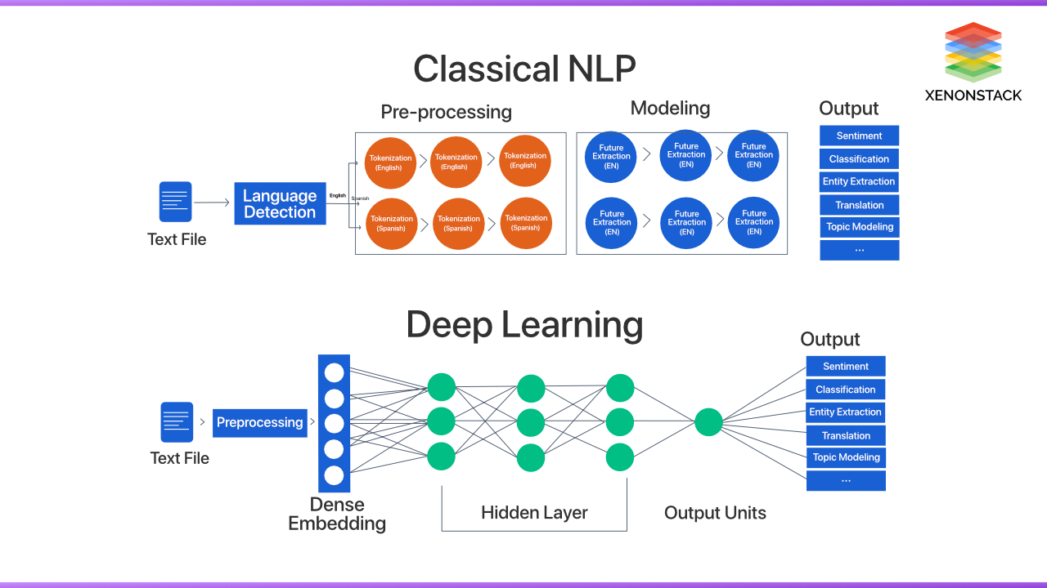
https://www.xenonstack.com/blog/natural-language-processing

Slide 6
NLP Pipeline
Text Preprocessing
Feature Extraction
Modeling
Post-Processing
Deployment
Segmentation/ Tokenization
Normalization/ Lowercasing
Stopword Removal
Punctuation Removal
Stemming/ Lemmatization
Depedency parsing
Part-of-Speech Tagging
Bag of Words (BoW)
TF-IDF
Word Embeddings
Machine Learning
Deep Learning
Prediction
Evaluation
Fine-Tuning
Production
Monitoring and Updating

Slide 7
NLP Pipeline
Feature Extraction adalah proses otomatis untuk mengambil informasi yang relevan dari data mentah dan mengubahnya menjadi representasi yang dapat digunakan oleh model machine learning.
Feature Engineering adalah proses manual di mana seorang data scientist atau engineer menciptakan atau memilih fitur-fitur yang relevan dari data yang ada untuk meningkatkan kinerja model machine learning.
Information Extraction adalah proses otomatis untuk mengambil informasi tertentu dari teks yang tidak terstruktur dan mengubahnya menjadi data yang terstruktur. Berbeda dengan feature extraction yang lebih fokus pada representasi data untuk model, information extraction lebih fokus pada pengambilan entitas, hubungan, atau fakta yang spesifik dari teks.

Slide 8
Three different approaches to NLP (1)
Rules-based NLP: The earliest NLP applications were simple if-then decision trees, requiring preprogrammed rules. They are only able to provide answers in response to specific prompts, such as the original version of Moviefone. Because there is no machine learning or AI capability in rules-based NLP, this function is highly limited and not scalable.
https://www.ibm.com/topics/natural-language-processing

Slide 9
Three different approaches to NLP (2)
Statistical NLP: Developed later, statistical NLP automatically extracts, classifies and labels elements of text and voice data, and then assigns a statistical likelihood to each possible meaning of those elements. This relies on machine learning, enabling a sophisticated breakdown of linguistics such as part-of-speech tagging.
Statistical NLP introduced the essential technique of mapping language elements—such as words and grammatical rules—to a vector representation so that language can be modeled by using mathematical (statistical) methods, including regression or Markov models. This informed early NLP developments such as spellcheckers and T9 texting (Text on 9 keys, to be used on Touch-Tone telephones).
https://www.ibm.com/topics/natural-language-processing

Slide 10
Three different approaches to NLP (3)
Deep learning NLP: Recently, deep learning models have become the dominant mode of NLP, by using huge volumes of raw, unstructured data—both text and voice—to become ever more accurate. Deep learning can be viewed as a further evolution of statistical NLP, with the difference that it uses neural network models. There are several subcategories of models:
https://www.ibm.com/topics/natural-language-processing

Slide 11
Three different approaches to NLP (3)
Sequence-to-Sequence (seq2seq) models: Based on recurrent neural networks (RNN), they have mostly been used for machine translation by converting a phrase from one domain (such as the German language) into the phrase of another domain (such as English).
Transformer models: They use tokenization of language (the position of each token—words or subwords) and self-attention (capturing dependencies and relationships) to calculate the relation of different language parts to one another. Transformer models can be efficiently trained by using self-supervised learning on massive text databases. A landmark in transformer models was Google’s bidirectional encoder representations from transformers (BERT), which became and remains the basis of how Google’s search engine works.
https://www.ibm.com/topics/natural-language-processing

Slide 12
Three different approaches to NLP (3)
Autoregressive models: This type of transformer model is trained specifically to predict the next word in a sequence, which represents a huge leap forward in the ability to generate text. Examples of autoregressive LLMs include GPT, Llama, Claude and the open-source Mistral.
Foundation models: Prebuilt and curated foundation models can speed the launching of an NLP effort and boost trust in its operation. For example, the IBM Granite™ foundation models are widely applicable across industries. They support NLP tasks including content generation and insight extraction. Additionally, they facilitate retrieval-augmented generation, a framework for improving the quality of response by linking the model to external sources of knowledge. The models also perform named entity recognition which involves identifying and extracting key information in a text.
https://www.ibm.com/topics/natural-language-processing

Slide 13
Taxonomy of fields of study in NLP
Tim Schopf et al. 2023. Exploring the Landscape of Natural Language Processing Research. https://arxiv.org/pdf/2307.10652

Slide 14
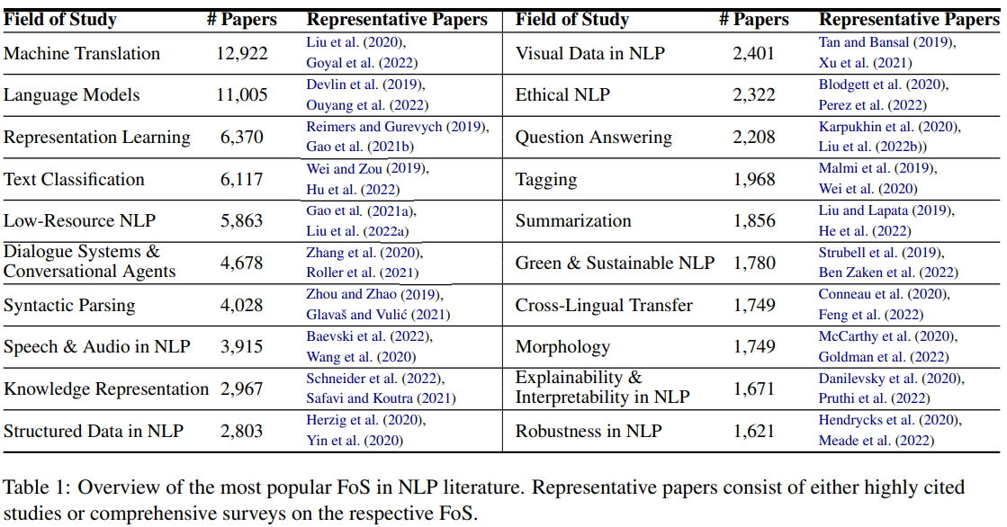
Taxonomy of fields of study in NLP
Tim Schopf et al. 2023. Exploring the Landscape of Natural Language Processing Research. https://arxiv.org/pdf/2307.10652

Slide 15
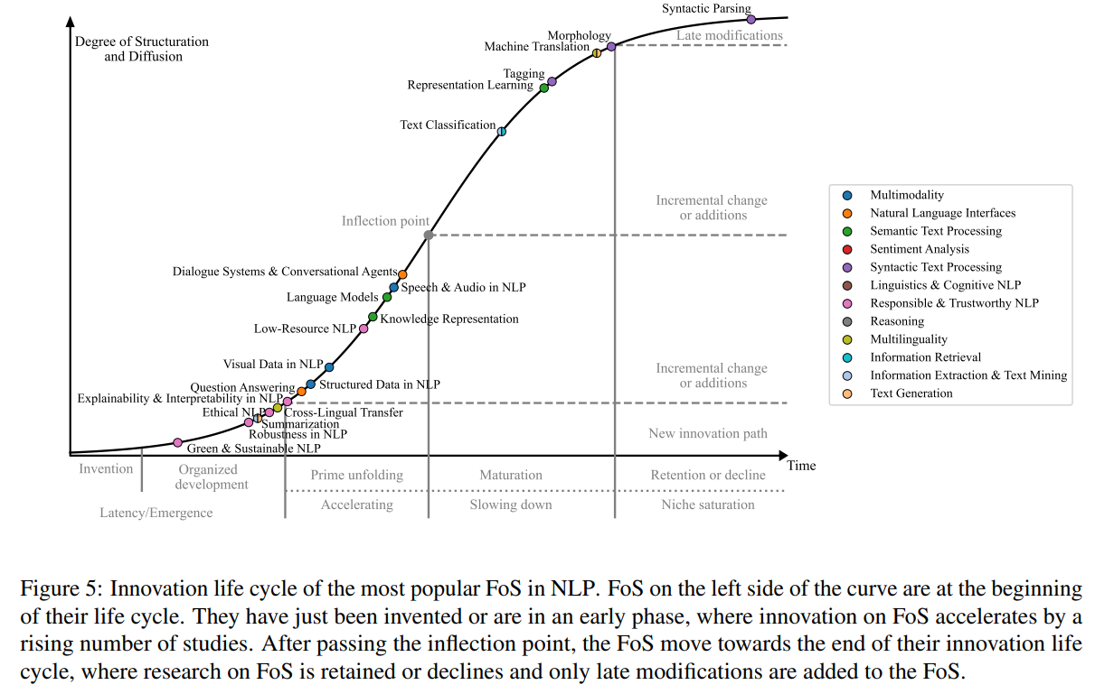
Taxonomy of fields of study in NLP
Tim Schopf et al. 2023. Exploring the Landscape of Natural Language Processing Research. https://arxiv.org/pdf/2307.10652

Slide 16
NLP task : Linguistic
Coreference resolution is the task of identifying if and when two words refer to the same entity. The most common example is determining the person or object to which a certain pronoun refers (such as, “she” = “Mary”). But it can also identify a metaphor or an idiom in the text (such as an instance in which “bear” isn’t an animal, but a large and hairy person).
Named entity recognition (NER) identifies words or phrases as useful entities. NER identifies “London” as a location or “Maria” as a person's name.
Part-of-speech tagging, also called grammatical tagging, is the process of determining which part of speech a word or piece of text is, based on its use and context. For example, part-of-speech identifies “make” as a verb in “I can make a paper plane,” and as a noun in “What make of car do you own?”
Word sense disambiguation is the selection of a word meaning for a word with multiple possible meanings. This uses a process of semantic analysis to examine the word in context. For example, word sense disambiguation helps distinguish the meaning of the verb “make” in “make the grade” (to achieve) versus “make a bet” (to place). Sorting out “I will be merry when I marry Mary” requires a sophisticated NLP system.
https://www.ibm.com/topics/natural-language-processing

Slide 17
NLP task : User-supporting
Speech recognition, also known as speech-to-text, is the task of reliably converting voice data into text data. Speech recognition is part of any application that follows voice commands or answers spoken questions. What makes speech recognition especially challenging is the way people speak—quickly, running words together, with varying emphasis and intonation.
Natural language generation (NLG) might be described as the opposite of speech recognition or speech-to-text: NLG is the task of putting structured information into conversational human language. Without NLG, computers would have little chance of passing the Turing test, where a computer tries to mimic a human conversation. Conversational agents such as Amazon’s Alexa and Apple’s Siri are already doing this well and assisting customers in real time.
Natural language understanding (NLU) is a subset of NLP that focuses on analyzing the meaning behind sentences. NLU enables software to find similar meanings in different sentences or to process words that have different meanings.
Sentiment analysis attempts to extract subjective qualities—attitudes, emotions, sarcasm, confusion or suspicion—from text. This is often used for routing communications to the system or the person most likely to make the next response.
https://www.ibm.com/topics/natural-language-processing

Slide 18
NLP use cases across businesses
Customer assistance: Enterprises can deploy chatbots or virtual assistants to quickly respond to custom questions and requests. When questions become too difficult for the chatbot or virtual assistant, the NLP system moves the customer over to a human customer service agent.
FAQ: Not everyone wants to read to discover an answer. Fortunately, NLP can enhance FAQs: When the user asks a question, the NLP function looks for the best match among the available answers and brings that to the user’s screen. Many customer questions are of the who/what/when/where variety, so this function can save staff from having to repeatedly answer the same routine questions.
Grammar correction: The rules of grammar can be applied within word processing or other programs, where the NLP function is trained to spot incorrect grammar and suggest corrected wordings.
Machine translation: Google Translate is an example of widely available NLP technology at work. Truly useful machine translation involves more than replacing words from one language with words of another. Effective translation accurately captures the meaning and tone of the input language and translates it to text with the same meaning and desired impact in the output language.
https://www.ibm.com/topics/natural-language-processing

Slide 19
NLP use cases across businesses
Redaction of personally identifiable information (PII): NLP models can be trained to quickly locate personal information in documents that might identify individuals. Industries that handle large volumes of sensitive information—financial, healthcare, insurance and legal firms—can quickly create versions with the PII removed.
Sentiment analysis: After being trained on industry-specific or business-specific language, an NLP model can quickly scan incoming text for keywords and phrases to gauge a customer’s mood in real-time as positive, neutral or negative. The mood of the incoming communication can help determine how it will be handled. And the incoming communication doesn’t have to be live: NLP can also be used to analyze customer feedback or call center recordings.
Spam detection: Many people might not think of spam detection as an NLP solution, but the best spam detection technologies use NLP’s text classification capabilities to scan emails for language indicating spam or phishing. These indicators can include overuse of financial terms, characteristic bad grammar, threatening language, inappropriate urgency or misspelled company names.
https://www.ibm.com/topics/natural-language-processing

Slide 20
NLP use cases across businesses
Text generation: NLP helps put the “generative” into generative AI. NLP enables computers to generate text or speech that is natural-sounding and realistic enough to be mistaken for human communication. The generated language might be used to create initial drafts of blogs, computer code, letters, memos or tweets. With an enterprise-grade system, the quality of generated language might be sufficient to be used in real time for autocomplete functions, chatbots or virtual assistants.
Text summarization: Text summarization uses NLP techniques to digest huge volumes of digital text and create summaries and synopses for indexes, research databases, for busy readers who don't have time to read the full text. The best text summarization applications use semantic reasoning and natural language generation (NLG) to add useful context and conclusions to summaries.
https://www.ibm.com/topics/natural-language-processing

Slide 21
NLP use cases by industry
Finance: In financial dealings, nanoseconds might make the difference between success and failure when accessing data, or making trades or deals. NLP can speed the mining of information from financial statements, annual and regulatory reports, news releases or even social media.
Healthcare: New medical insights and breakthroughs can arrive faster than many healthcare professionals can keep up. NLP and AI-based tools can help speed the analysis of health records and medical research papers, making better-informed medical decisions possible, or assisting in the detection or even prevention of medical conditions.
Insurance: NLP can analyze claims to look for patterns that can identify areas of concern and find inefficiencies in claims processing—leading to greater optimization of processing and employee efforts.
Legal: Almost any legal case might require reviewing mounds of paperwork, background information and legal precedent. NLP can help automate legal discovery, assisting in the organization of information, speeding review and helping ensure that all relevant details are captured for consideration.
https://www.ibm.com/topics/natural-language-processing

Slide 22
+ Applications of NLP
Automate routine tasks: Chatbots powered by NLP can process a large number of routine tasks that are handled by human agents today, freeing up employees to work on more challenging and interesting tasks. For example, chatbots and Digital Assistants can recognize a wide variety of user requests, match them to the appropriate entry in a corporate database, and formulate an appropriate response to the user.
Improve search: NLP can improve on keyword matching search for document and FAQ retrieval by disambiguating word senses based on context (for example, “carrier” means something different in biomedical and industrial contexts), matching synonyms (for example, retrieving documents mentioning “car” given a search for “automobile”), and taking morphological variation into account (which is important for non-English queries). Effective NLP-powered academic search systems can dramatically improve access to relevant cutting-edge research for doctors, lawyers, and other specialists.
Search engine optimization: NLP is a great tool for getting your business ranked higher in online search by analyzing searches to optimize your content. Search engines use NLP to rank their results—and knowing how to effectively use these techniques makes it easier to be ranked above your competitors. This will lead to greater visibility for your business.
https://www.oracle.com/id/artificial-intelligence/what-is-natural-language-processing/

Slide 23
+ Applications of NLP
Analyzing and organizing large document collections: NLP techniques such as document clustering and topic modeling simplify the task of understanding the diversity of content in large document collections, such as corporate reports, news articles, or scientific documents. These techniques are often used in legal discovery purposes.
Social media analytics: NLP can analyze customer reviews and social media comments to make better sense of huge volumes of information. Sentiment analysis identifies positive and negative comments in a stream of social-media comments, providing a direct measure of customer sentiment in real time. This can lead to huge payoffs down the line, such as increased customer satisfaction and revenue.
Market insights: With NLP working to analyze the language of your business’ customers, you’ll have a better handle on what they want, and also a better idea of how to communicate with them. Aspect-oriented sentiment analysis detects the sentiment associated with specific aspects or products in social media (for example, “the keyboard is great, but the screen is too dim”), providing directly actionable information for product design and marketing.
Moderating content: If your business attracts large amounts of user or customer comments, NLP enables you to moderate what’s being said in order to maintain quality and civility by analyzing not only the words, but also the tone and intent of comments.
https://www.oracle.com/id/artificial-intelligence/what-is-natural-language-processing/

Slide 24
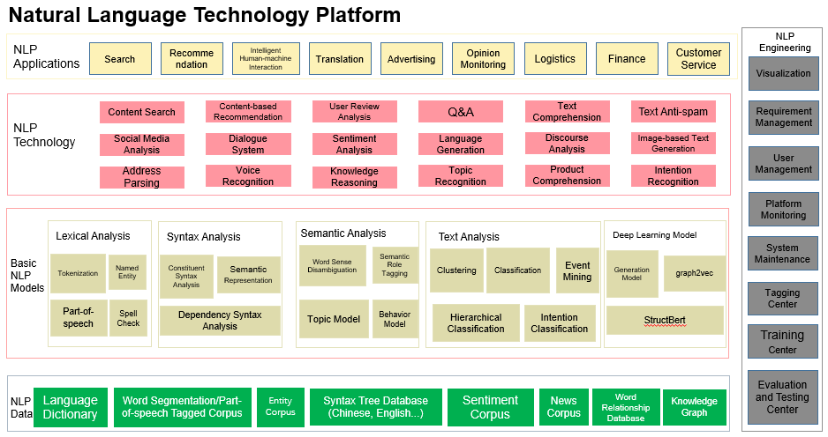
https://www.alibabacloud.com/blog/natural-language-intelligence-building-a-language-bridge-for-business_596417

Slide 25
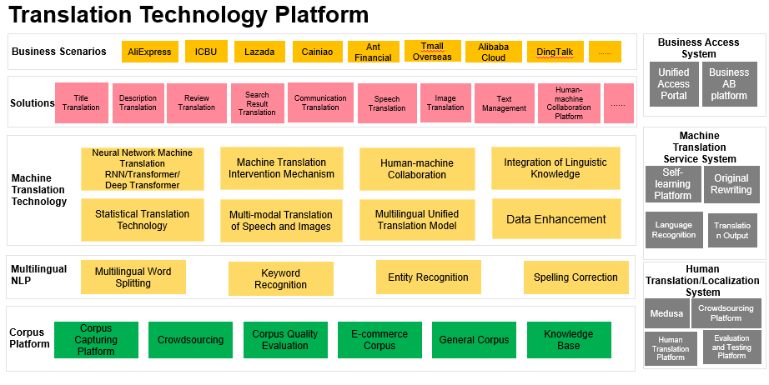
https://www.alibabacloud.com/blog/natural-language-intelligence-building-a-language-bridge-for-business_596417

Slide 26
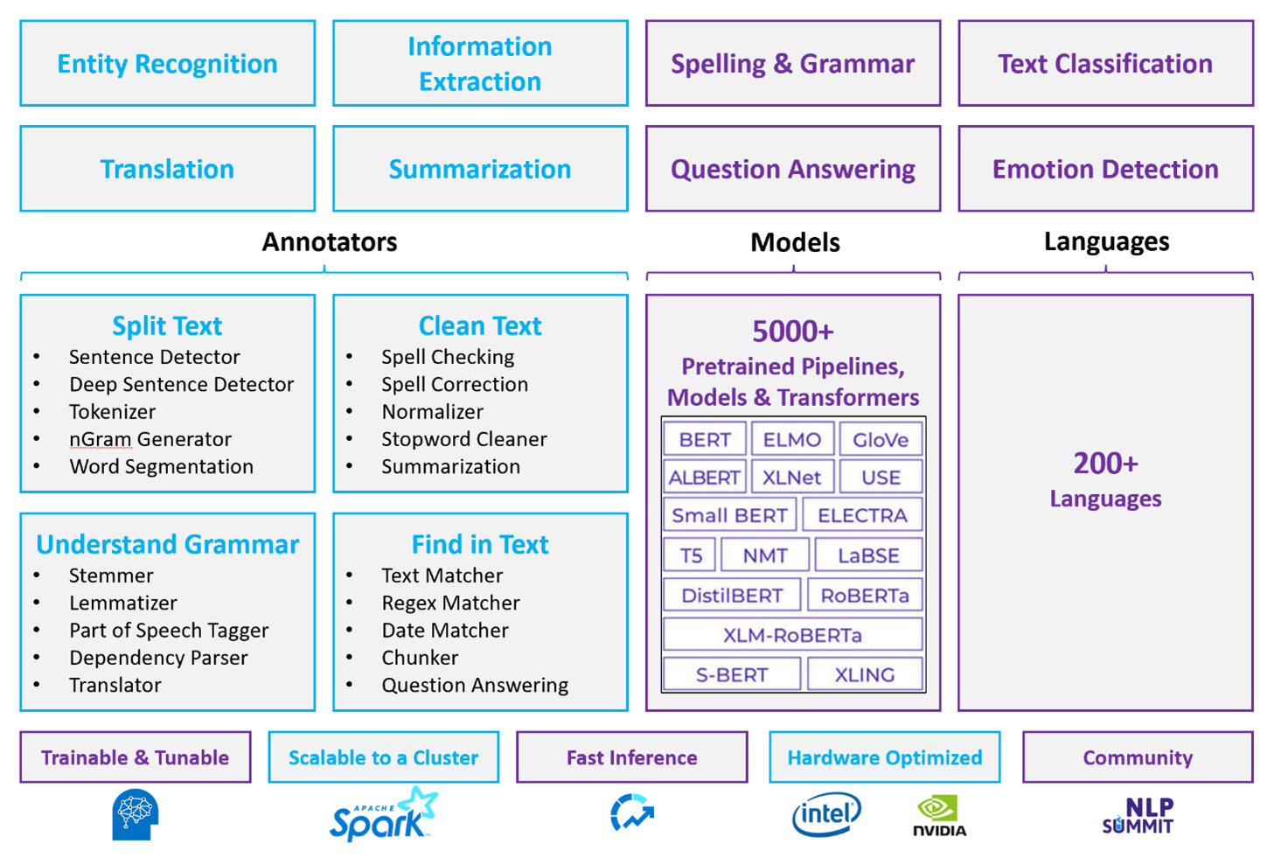
https://learn.microsoft.com/en-us/azure/architecture/data-guide/technology-choices/natural-language-processing

Slide 27
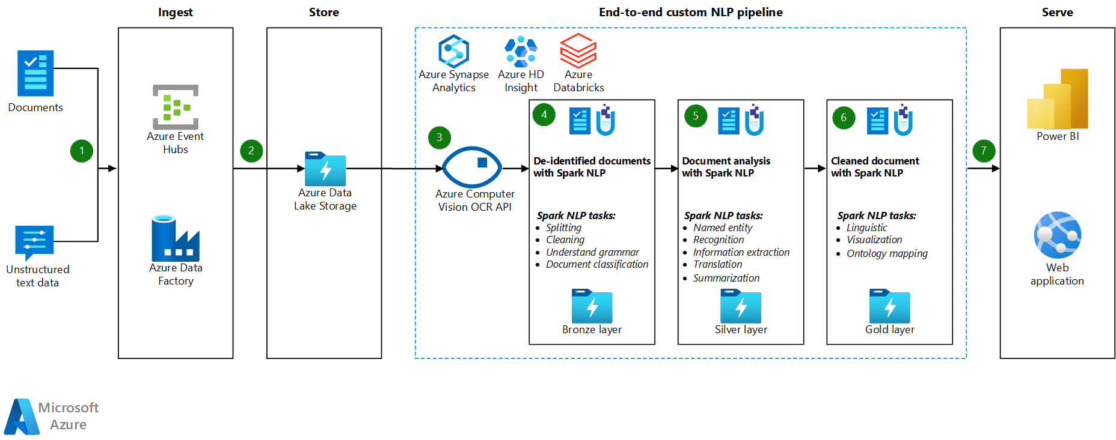
https://learn.microsoft.com/en-us/azure/architecture/ai-ml/idea/large-scale-custom-natural-language-processing

Slide 28
Tugas
Cari 10 jurnal terkait perkembangan NLP terkini (5tahun terakhir)
Cari 10 teknologi NLP yang yang telah diadopsi oleh Industri/ Government/Perusahaan TI
Diskusikan dalam Forum
Tuliskan dalam laporan (dikumpulkan saat UTS)

Slide 29

Universitas Pamulang
Prodi Teknik Informatika S-2
Sajarwo Anggai
Dosen – Universitas Pamulang
NIDN : 0421108703
Email : dosen02832@unpam.ac.id
WA : 08977406656
Terima Kasih

